Slide 1
How Populations Evolve

Slide 2
Charles Darwin
Influenced by Charles Lyell – Scottish geologist that wrote natural forces gradually change the Earth’s surface
During his trip and on the Galapagos Islands, made observations about similarities and differences of plants and animals in South America
Darwin developed the Theory of Natural Selection based on his observations.

Slide 3
Theory of Natural Selection
Natural Selection - organisms better adapted to their environment tend to survive and produce more offspring.
Natural Selection may lead to overall changes the genes and traits present in a population
Adaptations – unique traits an individual possesses

Slide 4
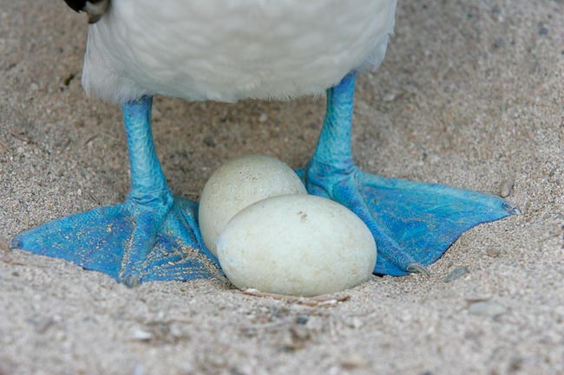
Observations of Natural Selection
More offspring are born than can survive

Slide 5
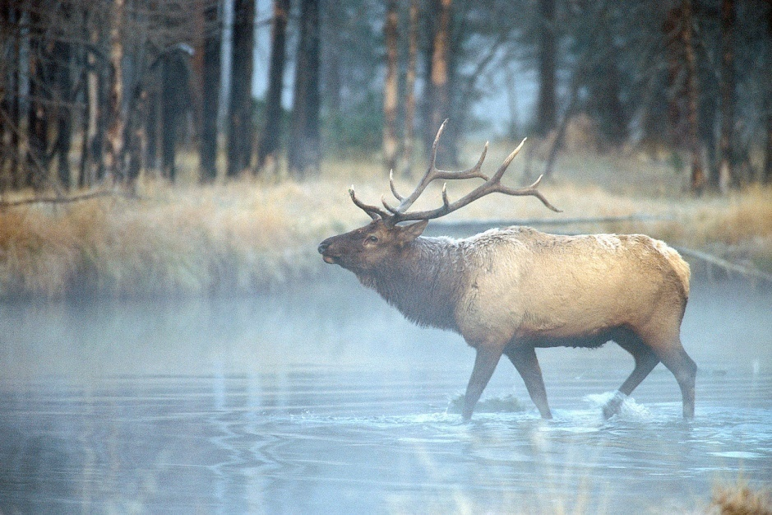
Observations of Natural Selection
Natural resources are limited

Slide 6
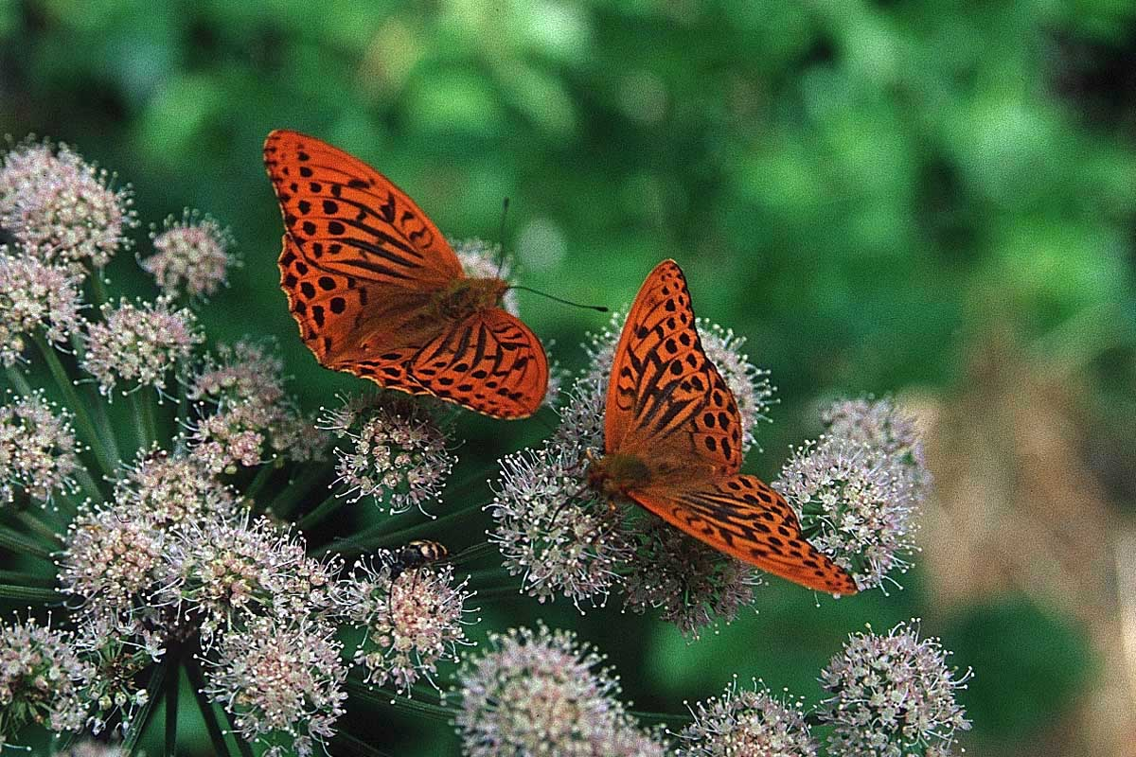
Observations of Natural Selection
Individuals of a population vary in their characteristics and those traits are passed on to their offspring

Slide 7
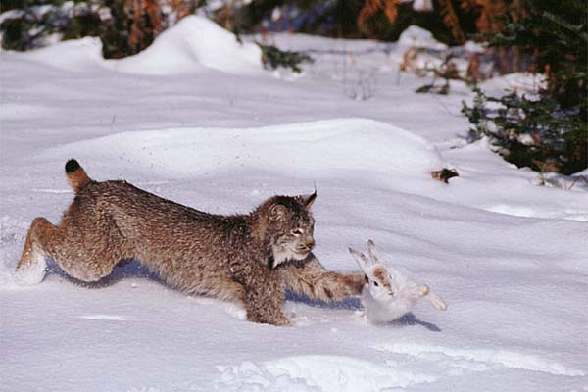
Observations of Natural Selection
“Survival of the Fittest” – individuals with the best traits will survive the longest to reproduce.

Slide 8
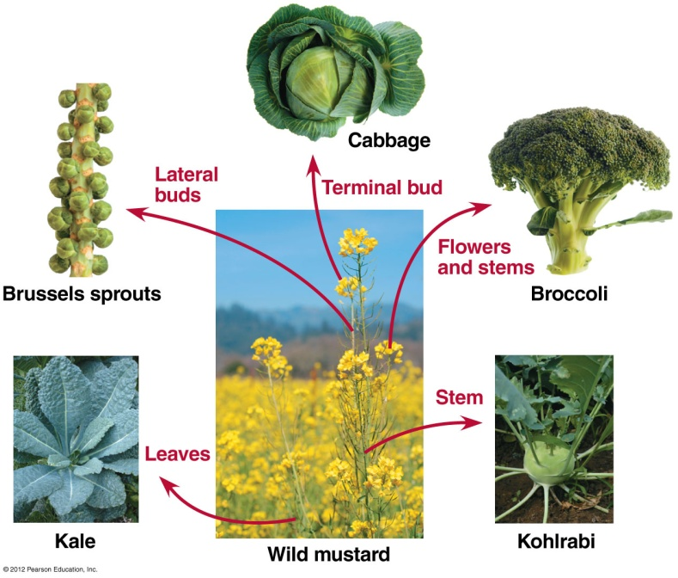
Humans have been influencing Natural Selection for years…
Artificial Selection
The selective breeding of domesticated plants and animals
Humans would only breed individuals with the favored traits

Slide 9
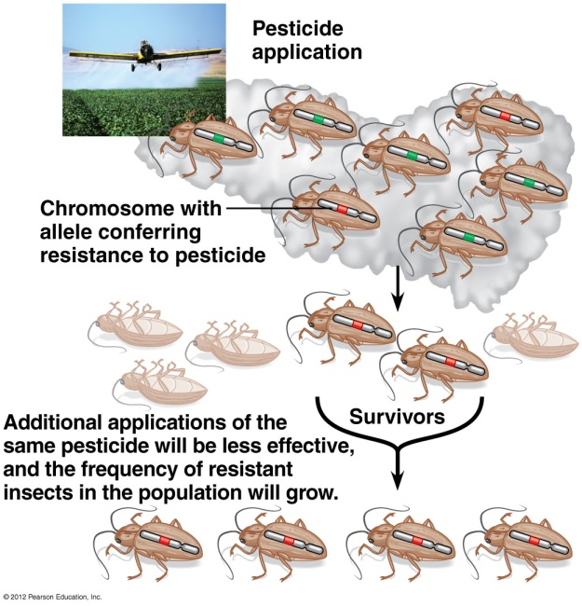

Slide 10
Natural Selection effects on a Population
Populations – a group of individuals of the same species living in the same habitat
Evolution does not affect the individual, it affects the population
Population genetics – genetic change in a population

Slide 11
Survival of the Fittest effects population
Fitness – contribution an individual makes to the gene pool of the next generation relative to the contribution of other individuals
Individuals with favorable traits will have a high fitness level.

Slide 12
Microevolution Changes the Gene Pool
Gene pool – total collection of genes in a population at any one time
Microevolution – relative frequencies of alleles in a population change over a number of generations

Slide 13
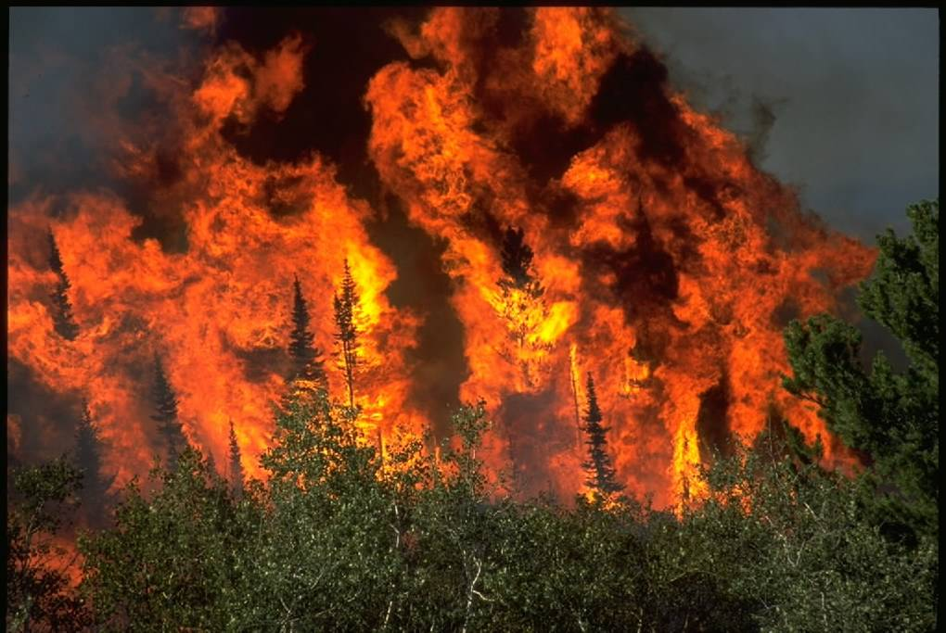
Five Causes of Microevolution
Genetic Drift – change in gene pool of a small population due to chance
Examples: Natural Disaster, epidemic

Slide 14
Genetic Drift
Bottleneck effect – genetic drift resulting from an event that drastically reduces population size

Slide 15
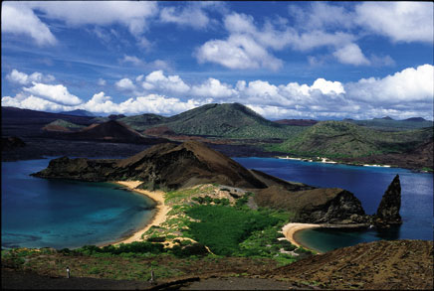
Genetic Drift
Founder effect – colonization of a new location by a small number of individuals

Slide 16
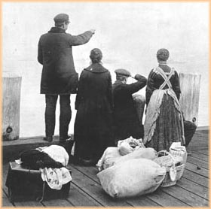
Five Causes of Microevolution
Gene Flow - gain or loss of alleles from a population by the movement of individuals or gametes

Slide 17
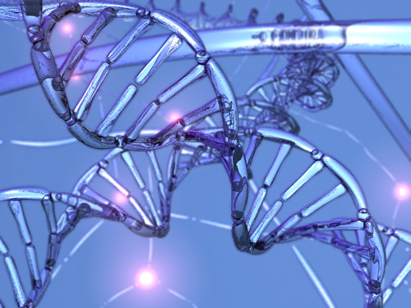
Five Causes of Microevolution
Mutation - random change in an organism’s DNA that creates a new allele

Slide 18
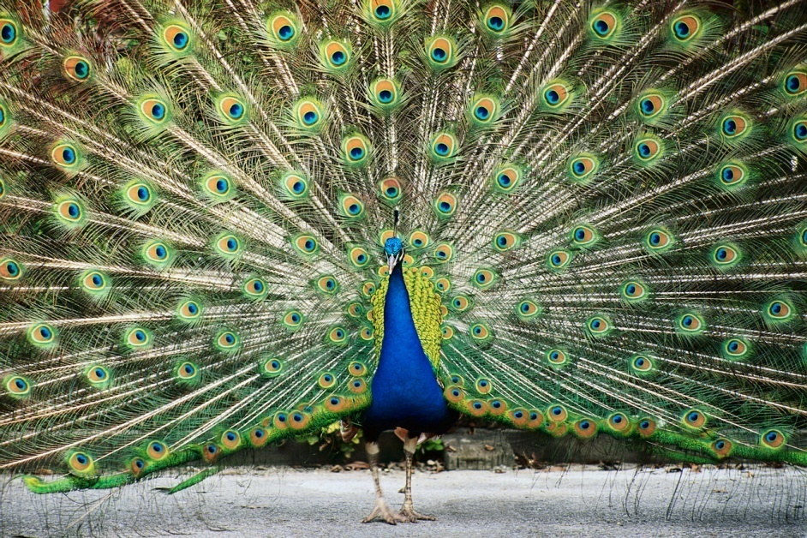
Five Causes of Microevolution
Non-random mating – males with specific traits have a higher chance of mating with females than males not possessing those traits.
In other words, not all males of an equal chance of reproducing

Slide 19
Five Causes of Microevolution
Natural selection reduces variation
Some recessive alleles may never be fully eliminated from the population:
Recessive genes are hidden in the heterozygote
Heterozygote advantage – heterozygotes have a greater reproductive success than homozygotes

Slide 20
Modes of Natural Selection
Natural Selection will shift the gene pool or the overall look of a population.
There are 3 modes of Natural Selection that favors different phenotypes

Slide 22
Modes of Natural Selection
Stabilizing selection – favors intermediate variants

Slide 23
Modes of Natural Selection
Directional selection – acts against individuals at one phenotypic extreme

Slide 24
Modes of Natural Selection
Diversifying selection – favors individuals at both extremes of a phenotypic range

Slide 25
Evidence of Evolution
Fossils
Biogeography
Homologous Structures
Vestigal Structures
Molecular Biology – shared DNA4
Embryology – similar embryos

Slide 26
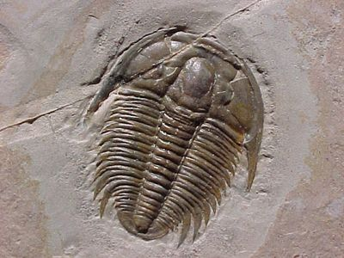
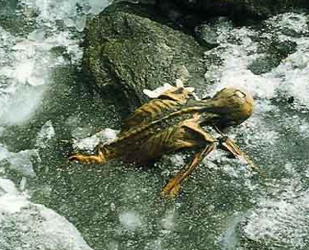
Fossils
Fossil Record – the sequence in which fossils appear within layers of sedimentary rock

Slide 27
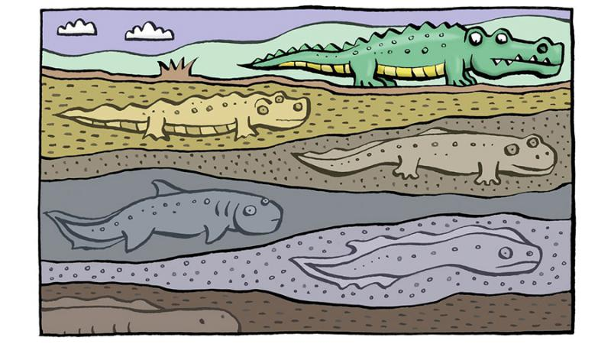

Slide 28
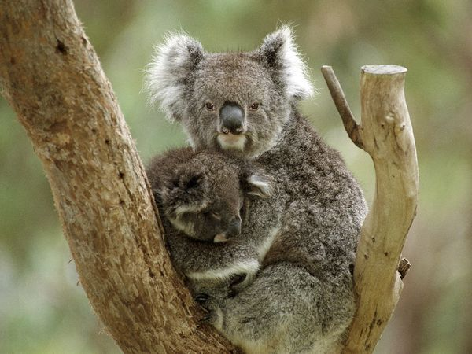
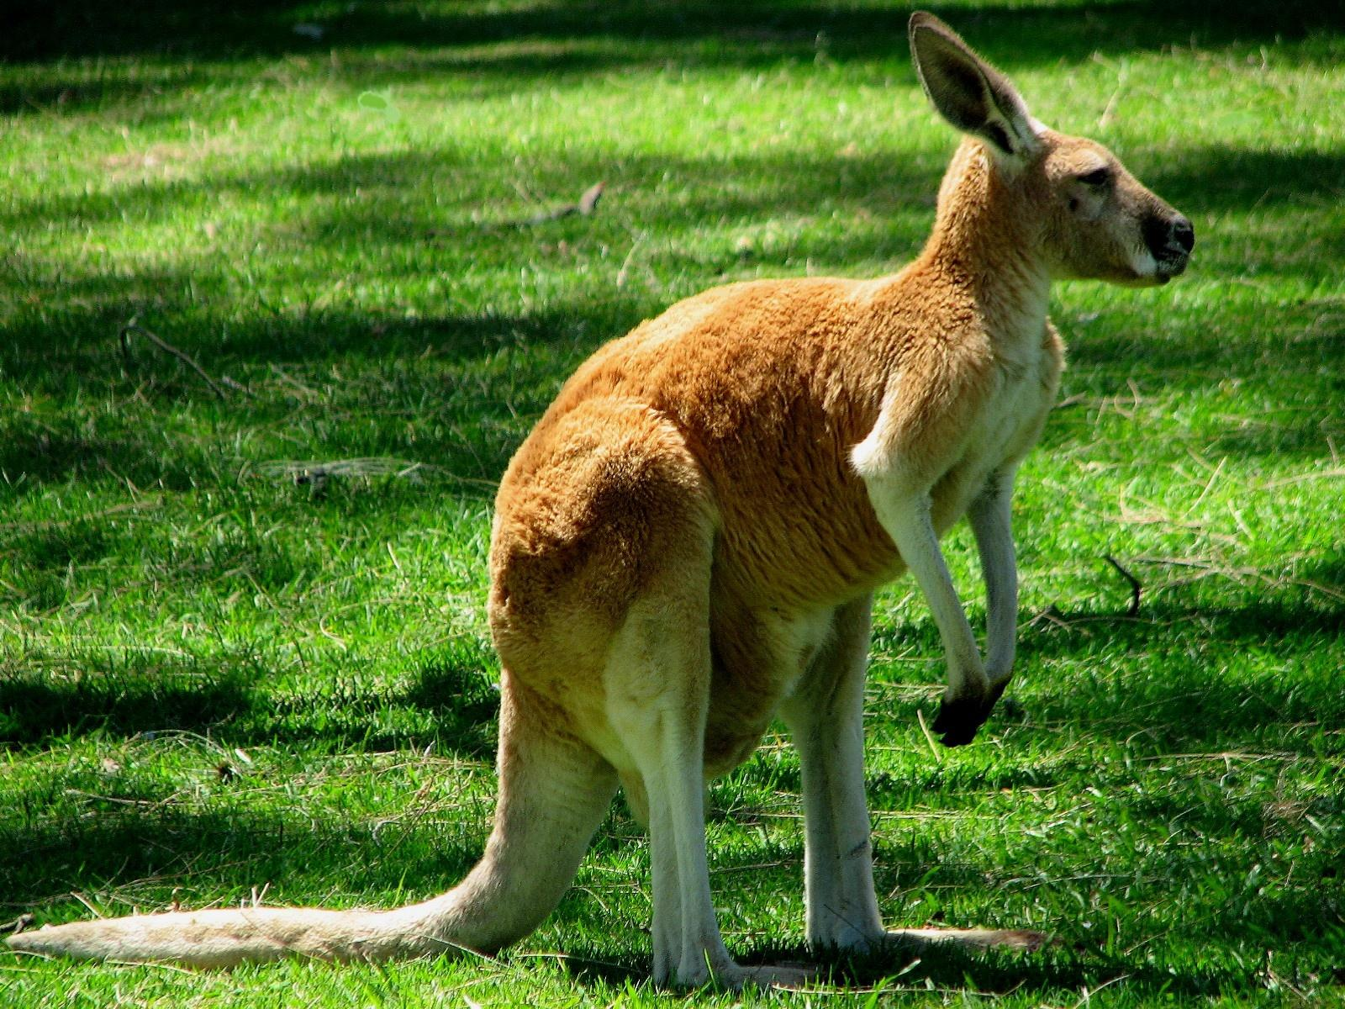
Biogeography
Organisms resemble organisms that live closer to them than organisms much more distant

Slide 29
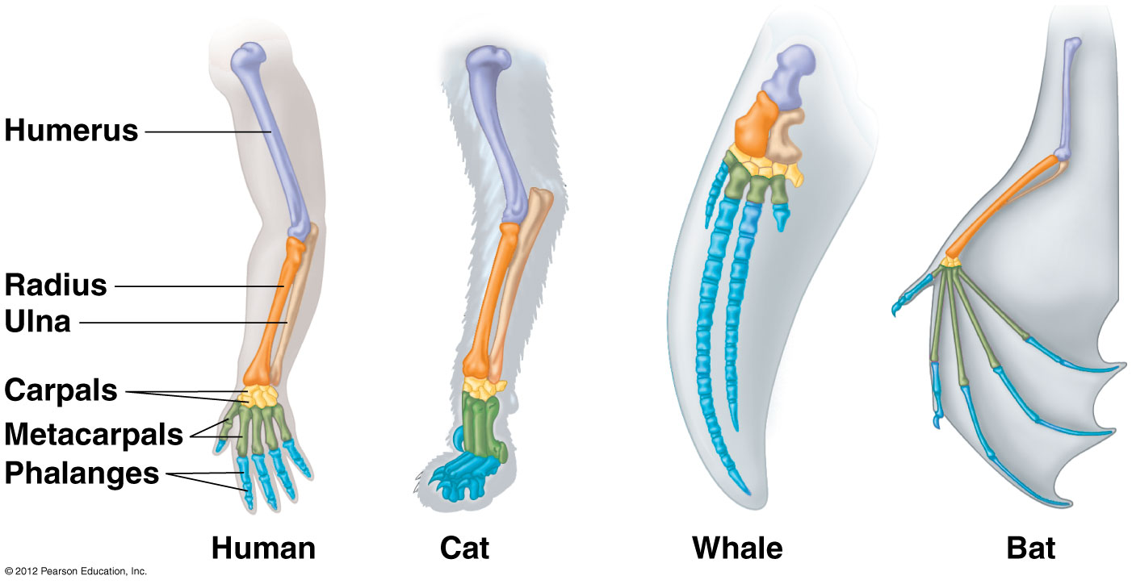
Homologous Structures
Similarity in characteristics that result from common ancestry

Slide 30
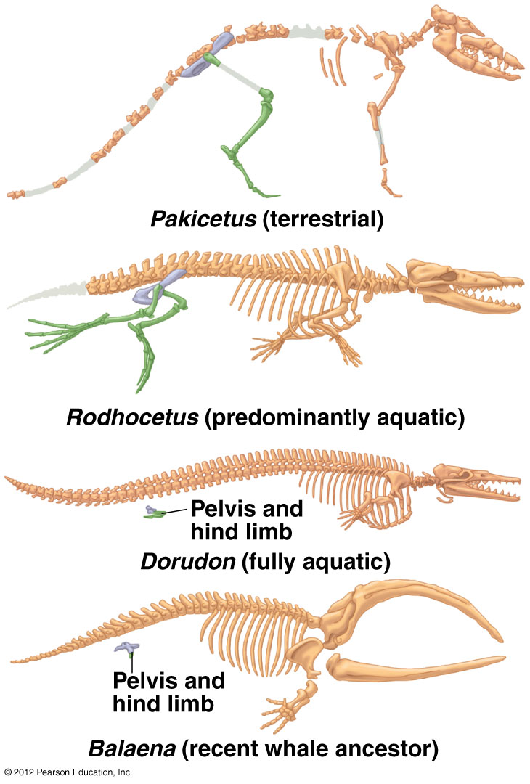
Vestigial Structure
Remnants of features that served important functions in the organisms’ ancestors.

Slide 31
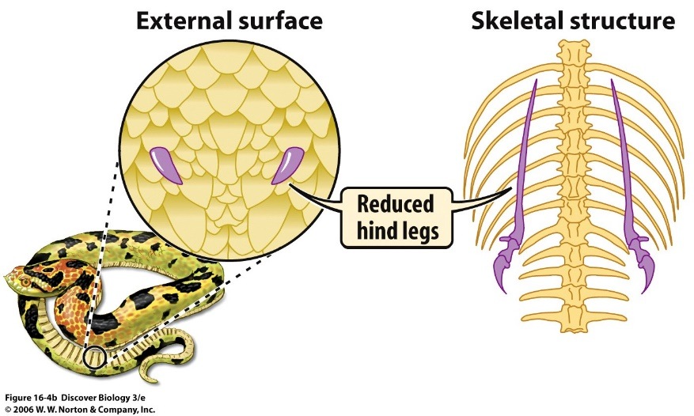

Slide 32
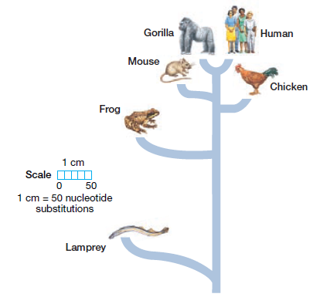
Molecular Biology
Molecular history in the DNA sequences of organisms

Slide 33
Embryology

Slide 34
