Slide 1
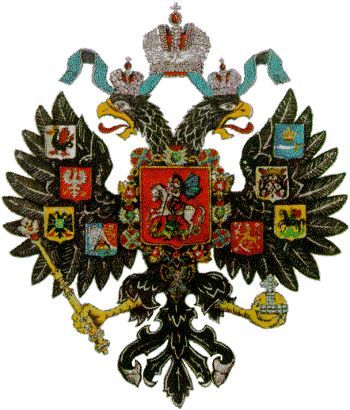
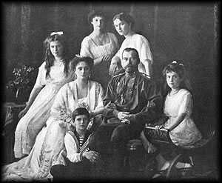
The European Royal Family
1
2
3
4
5
6
7
8
9
10
11
12
13
14
15
16
17
18
19
20
21
22
23
24
25
26
27
28
29
30
31
32
33
34
35
44
36
37
38
39
40
41
42
43
45
46
47
48
49
50
51
52
All Assassinated

